Slide 1








Human Computer Interface ICTE 3002
HelpEra
“Unbox Your Inner Clarity”
Presented By: UXplorers
Members:
Resham Furqan, Maria Waheed,
Blessed Dendere, Natalee De Silva
Kekweditse Mogoshadi Mogoba
Resham Furqan

Slide 2


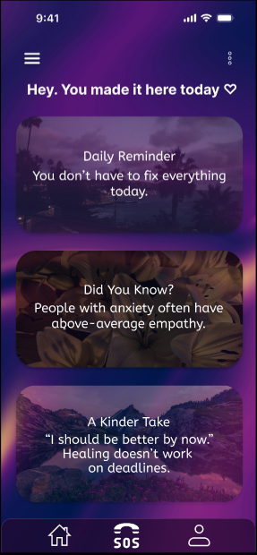
Human Computer Interface ICTE 3002
What is HelpEra?
  Core Mission: A proactive safety companion designed to bridge the gap between concern and security.
  Design Philosophy: Utilising a minimalist glassmorphism aesthetic to reduce user anxiety during high-stress moments.
  Our Passion: Transitioning from "clinical" emergency tools to a supportive, community-focused guardian.
Resham Furqan

Slide 3


Human Computer Interface ICTE 3002
THE PROBLEM
High-Stress Complexity
Response Lag
Clinical Isolation
Traditional reporting tools are buried under multiple menus, making them nearly impossible to use during an actual crisis.
A significant "Efficiency Gap" exists where the time required to navigate an app exceeds the user’s cognitive capability during a high-adrenaline event.
Existing apps feel like "police tools" rather than supportive companions, leading to low user engagement and a lack of community-based prevention.
Resham Furqan

Slide 4
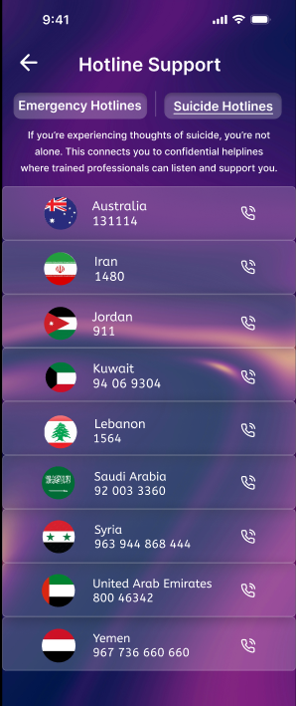
Human Computer Interface ICTE 3002
THE SOLUTION
One-Tap Efficiency
Calming Aesthetic
Proactive Security
We eliminated complexity by placing critical reporting tools just one tap away, ensuring action is possible even in high-stress moments.
The glassmorphism and minimalist layout were intentionally chosen to reduce cognitive load and soothe user anxiety, unlike traditional clinical apps.
Beyond just emergency help, HelpEra provides real-time "Safe Zone" tracking and community-driven insights to prevent incidents before they happen.
Resham Furqan

Slide 5




Human Computer Interface ICTE 3002
USER RESEARCH METHODS
Online Survey
Interviews
Observations
Surveyed students and young adults to collect data on stress, anxiety, app usage, support needs, and common user problems.
Conducted interviews and questionnaires to understand user experiences, challenges, pain points, and expectations from a mental health app.
Studied existing mental health apps and user behavior, and reviewed research to identify design gaps and opportunities.
Target users: Young adults & students
Goal: Understand user problems, needs, and expectations
Maria Waheed

Slide 6








Human Computer Interface ICTE 3002
KEY FINDINGS FROM USER RESEARCH
Insights gathered from surveys, interviews, and observations
Stress
High stress and anxiety levels
Help
Don’t know where to seek help
Privacy
Need privacy and anonymity
Quick
Need quick access to support
Simple
Apps too clinical/complicated
Support
Want emotional guidance tools
Maria Waheed

Slide 7
Human Computer Interface ICTE 3002
USER NEEDS
Requirements identified from user research findings
Emotional Needs
Functional Needs
  Emotional support and guidance
  Feel safe and supported
  Privacy and anonymity
  Calm and stress-free environment
  Encouragement and reassurance
  Simple and easy interface
  Quick access to help and support
  Journaling and mood tracking tools
  Educational mental health content
  Easy navigation and accessibility
These user needs guided our design decisions and feature development.
Maria Waheed

Slide 8
Human Computer Interface ICTE 3002
DESIGN IMPLICATION
How user research influenced our design decisions
User Need | Design Solution
Simple interface | Minimalist UI design
Privacy | Anonymous and secure features
Quick access to help | One-tap emergency and support
Emotional support | Journaling and support cards
Reduce stress | Calm colors and glassmorphism design
Guidance | Educational content and resources
Maria Waheed

Slide 9
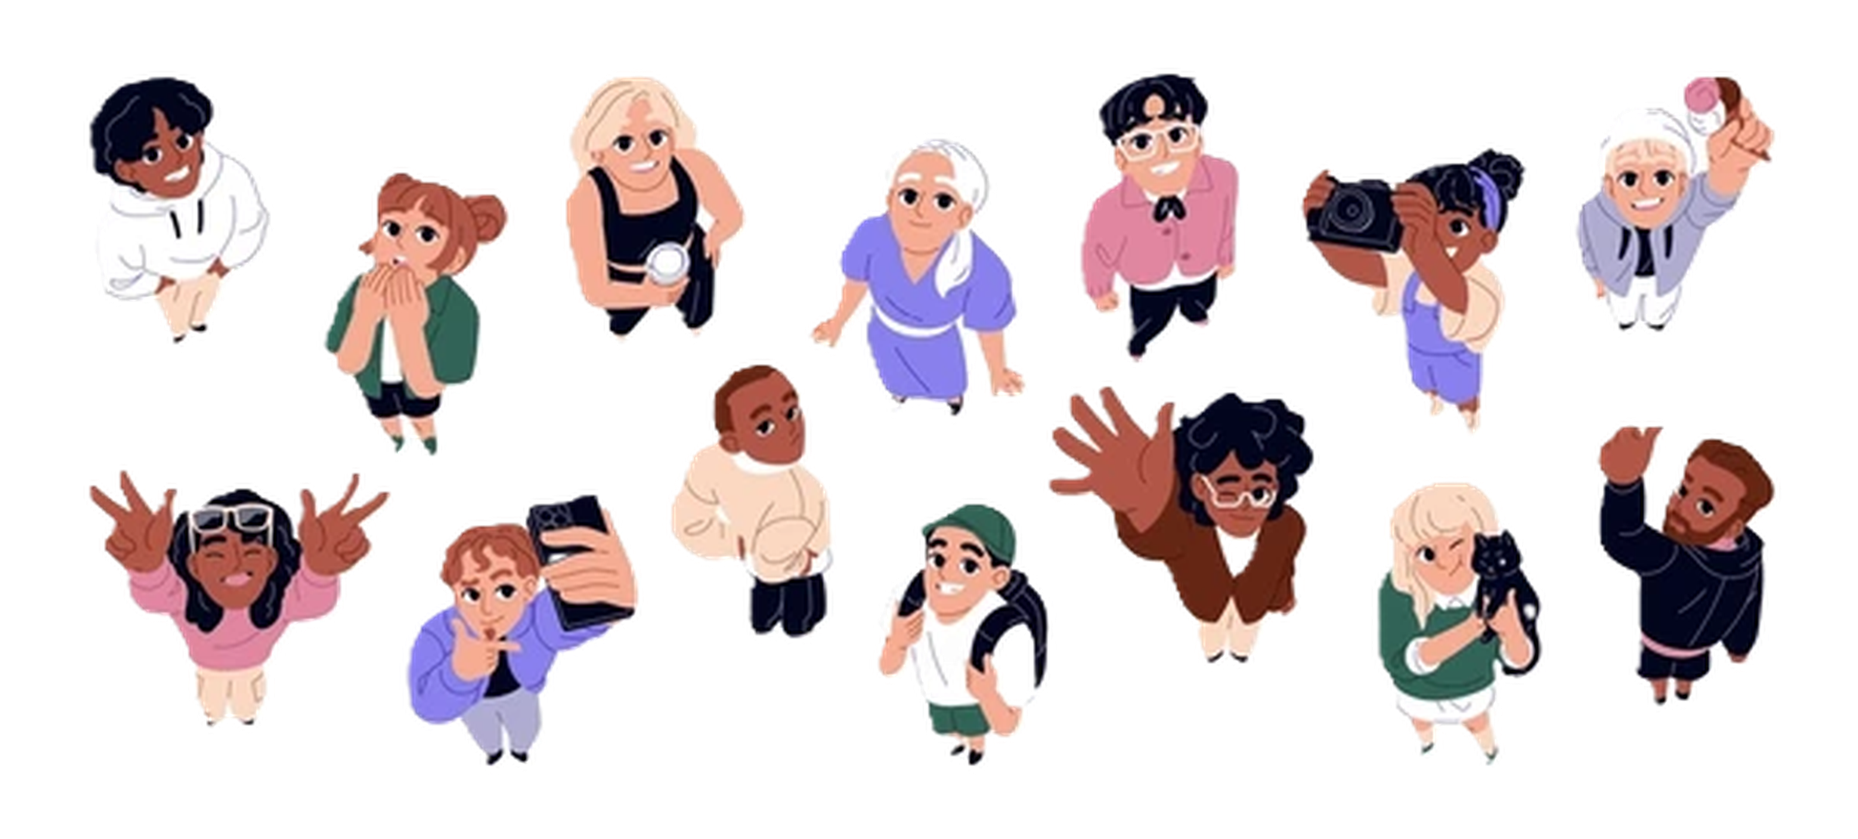

Human Computer Interface ICTE 3002
PERSONAS
Personas are fictional characters created based on our research to represent the different user types that might use our app. Creating personas will helped us understand the users’ needs, experiences, behaviors and goals.
Our two main personas were created to represent individuals mental states under the influence of workplace experience, motivation, and inequality, especially in areas where individuals are subject to pressure-filled, fast-paced, and performance-based environments.
Blessed Dendere

Slide 10

Tinashe K. Dube
The Graphic Designer
“Losing my job would be the ruin of me”
Blessed Dendere
Human Computer Interface ICTE 3002

Slide 11

Age: 22
Gender: Male
Location: Dubai Internet City
Job Title: Junior Graphic Designer
Education: BA in Animation and Graphic Design
Tinashe works at a major company and struggles with the pressure to keep up with the intense fast paced workflow of his colleagues. He is also targeted by his manager and receives a salary that is significantly less than the contracted pay when he signed with company but struggles to bring it up to HR and the company. He has been attending therapy for 6 months and prefers remote counselling sessions.
Blessed Dendere
Human Computer Interface ICTE 3002

Slide 12

Sarah
Zhou
The Sales Assistant
“I’m more than qualified for the position, why should my gender stop it”
Blessed Dendere
Human Computer Interface ICTE 3002

Slide 13

Age: 31
Gender: Female
Location: Al Qasimia, Sharjah
Job Title: Sales Manager Assistant
Education: BA in Marketing and Business Administration
Sarah works in a competition driven company that strives for results more than the journey. The corporate environment is heavily influenced by which sex holds majority positions in the year end evaluation. She experiences stress from having to be a ‘women in a man’s field’ and experiences anxiety. She is looking for logical solutions to manage her stress that does not take time out of her schedule.
Blessed Dendere
Human Computer Interface ICTE 3002

Slide 14

Human Computer Interface ICTE 3002
Pain Points
Pain points are persistent issues a service’s users face that can be addressed through research and customer experiences.
During the course of our research, our team identified four main pain points that cause significant impact on users’ app experiences.
Blessed Dendere

Slide 15


Human Computer Interface ICTE 3002
Pain Point - 01
Technical and Performance
Stability
  Apps crash or freeze during use
  Unexpected bugs interrupt sessions.
Speed
  Slow loading time when accessing features or content on the app.
  Delays that may occur on the app
Notifications
  Inconsistent/delayed notifications
  Missed reminders to check in.
Blessed Dendere

Slide 16
Human Computer Interface ICTE 3002
Pain Point - 02
Social and Peer Interactions
Peer support challenges
  Support interactions may feel generic increasing emotional distress.
  Unclear guidelines on what to do during a crisis or resource(articles) are outdated.
  The risk of feeling isolated even in a community environment.
Peer support challenges
  Support interactions may feel generic increasing emotional distress.
  Unclear guidelines on what to do during a crisis or resource(articles) are outdated.
  The risk of feeling isolated even in a community environment.
Blessed Dendere

Slide 17

Human Computer Interface ICTE 3002
Pain Point - 03
Psychological and Emotional Barriers
Efficiency
  Does not provide certainty of what the app offers .
  Limited number of resources available.
  Users expected outcomes do not match the outcome.
  Hesitant in trusting automated AI-based advice.
Privacy
  Unable to determine the measures taken to protect users’ sensitive data.
  Uncertainty about how journal entries will be secured.
  Hesitant to engage fully because of confidentiality concerns.
Engagement
  Users feel guilty for missing daily reflection or exercise.
  Users not knowing their progress.
  Lack of reminders to maintain routine use.
Blessed Dendere

Slide 18
Human Computer Interface ICTE 3002
Pain Point - 04
Usability and Content Design
Information overload
  Overwhelming content.
  Key features and guides may be difficult to locate.
  Difficulty in prioritizing in which guides and articles to read.
Navigation difficulties
  Users struggle to find progress history.
  An unclear app design.
Operational and professional Matchmaking
  Access to appropriate professionals
  Difficulty finding a professional that meets preferences.
  Limited availability of trained mental health experts.
Accessibility issues
  Content difficult to read.
  Limited customizable settings.
  Content that's written in complex language.
Blessed Dendere

Slide 19
Human Computer Interface ICTE 3002
USER STORIES
User stories are concise, user-focused descriptions of desired outcomes focusing on who needs it, what they want, & why
As Sarah, I want to be aware of the app’s policies on data protection, so I can feel reassured about sharing my personal information
As Evan, I want to seek advice on breathing exercises, so that I can calm down my brother during panic attacks
As a manager, I want to learn about mental illness, so that I can improve the workplace environment.
As Ari, I want to see the patterns, so that I can share it with my therapist.
As a psychology student, I want to research mental cases so that I can do my assignments.
Blessed Dendere

Slide 20






Human Computer Interface ICTE 3002
CAUSES OF MENTAL HEALTH
Understanding the mental health app landscape
Purpose of Competitor Analysis
A structured evaluation on how platforms support user needs. This analysis guided
strategic positioning for HelpEra.
Selected Competitors
Key competitors such as 7 Cups and TalkLife were analysed due to their focus on peer-based emotional support.
Evaluation Criteria
Platforms were assessed based on
usability, support quality, safety
mechanisms, privacy protection.
Key Insight from Analysis
Impact on HelpEra Design
Competitors lack consistency,
structured guidance,
Findings directly informed HelpEra's UX
strategy, focusing on trust, structured
support, and reduced overlaod .
Kekweditse Mogoba

Slide 21
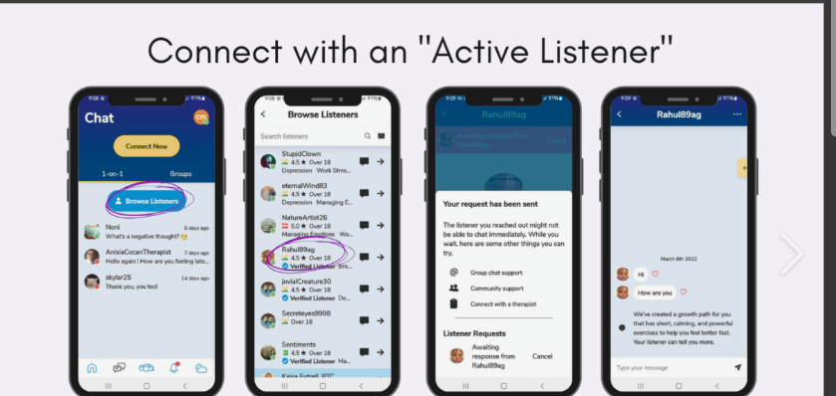

Human Computer Interface ICTE 3002
COMPETITOR ANALYSIS: 7 CUPS
  Platform overview: 7 Cups is a digital mental health service that allows people to get emotional support (through text or voice) anonymously from trained volunteers.
Strengths, limitations, and UX implications.
  Strengths: Their biggest strengths are that they provide immediate, 24/7 access to emotional support.
  UX Limitations: Their greatest limitations are inconsistent quality of support due to non-professional listeners and there is very little continuity of care.
  Safety and Trust Issues: They have very low safety mechanisms (including background checking of the listeners) and thus represent a potential risk.
  Design implications for HelpEra: HelpEra addresses these limitations by using verified professionals, providing well-defined support templates, allowing users to receive alerts if they feel unsafe, and allowing users to create continuity of care through an encrypted tracking of the users' journey.
Kekweditse Mogoba

Slide 22
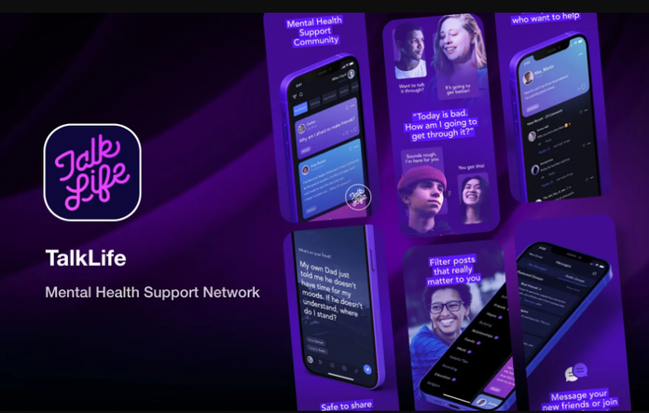
Human Computer Interface ICTE 3002
COMPETITOR ANALYSIS: TALKLIFE
  Platform overview: TalkLife is a global peer-support platform that allows users to connect through community posts and discuss their experiences, feelings, and challenges.
Strengths, Limitations, and UX Implications
  Strengths: This is an engaging platform, with real-time interaction between community members, solid AI moderation, helpful and transparent reporting systems.
  UX limitations: Content-dense feeds often overwhelm users and very few guiding actions (next steps) that can be taken as a result of posting their emotions.
  Unstructured Support: Little or no structure to how users can navigate support pathways and achieve the help they need.
  Design implications for HelpEra: HelpEra will implement a structured pathway for users to receive help and support. This will be accomplished through the introduction of guided supports. This will help reduce the feeling of being overwhelmed and improve clarity.
Kekweditse Mogoba

Slide 23






Human Computer Interface ICTE 3002
IDENTIFIED GAPS IN EXISTING SOLUTIONS
Key Limitations in Current Mental Health Apps
Inconsistent Support Quality
  There are no criteria for determining what constitutes a satisfactory standard of emotional support from peers on the platform.
Privacy and Trust Concerns
  Many platforms do not clearly state how they protect users' privacy; therefore, users may be reluctant to disclose sensitive or personal information.
Lack of Structured User Guidance
  Once users have expressed their feelings, they often do not know how to follow up or proceed, resulting in further confusion .
Content overload and Cognitive Strain
  With so much content/information heavy interfaces, users' ability to be productive or obtain any needed assistance is diminished significantly.
Limited Access to Professional Support
  Limited access to evidence-based professionals limits access to evidence-based services and creates gaps between peer supports and clinical supports resulting in disrupted continuity of care.
Kekweditse Mogoba

Slide 24



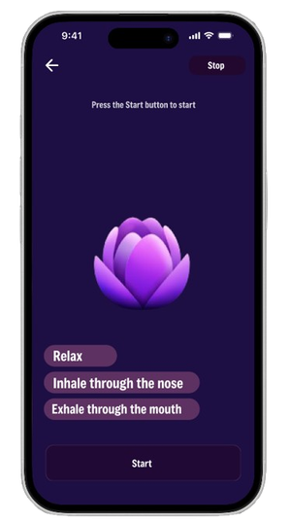
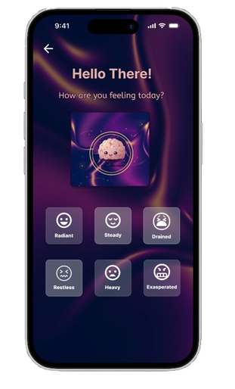
UX DESIGN DECISIONS AND PRINCIPLES
How HelpEra Adresses Identified Gaps
Mood Based Navigation
Users start with a simple check-in of their current emotional state, allowing for a personalized experience .
Cognitive Load Reduction
Minimalistic layouts and guided steps, and progressive disclosure for easy navigation.
Trust and Privacy Emphasized
Communication around privacy is clear, there are options for anonymity and clear communication on how thier data is handeled
Accessible and Inclusive
The design follows WCAG standards with readable typography, calming visuals, and intuitive interactions for incusivity.
Structured support systems
Guided tools like my journal, grounding exercises, a variety of learning paths.
Kekweditse Mogoba
Human Computer Interface ICTE 3002

Slide 25
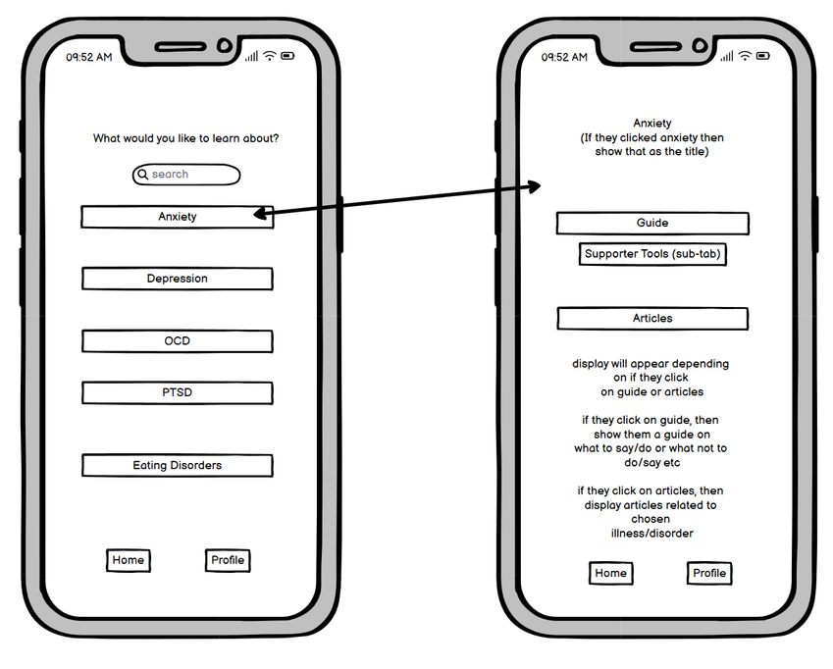
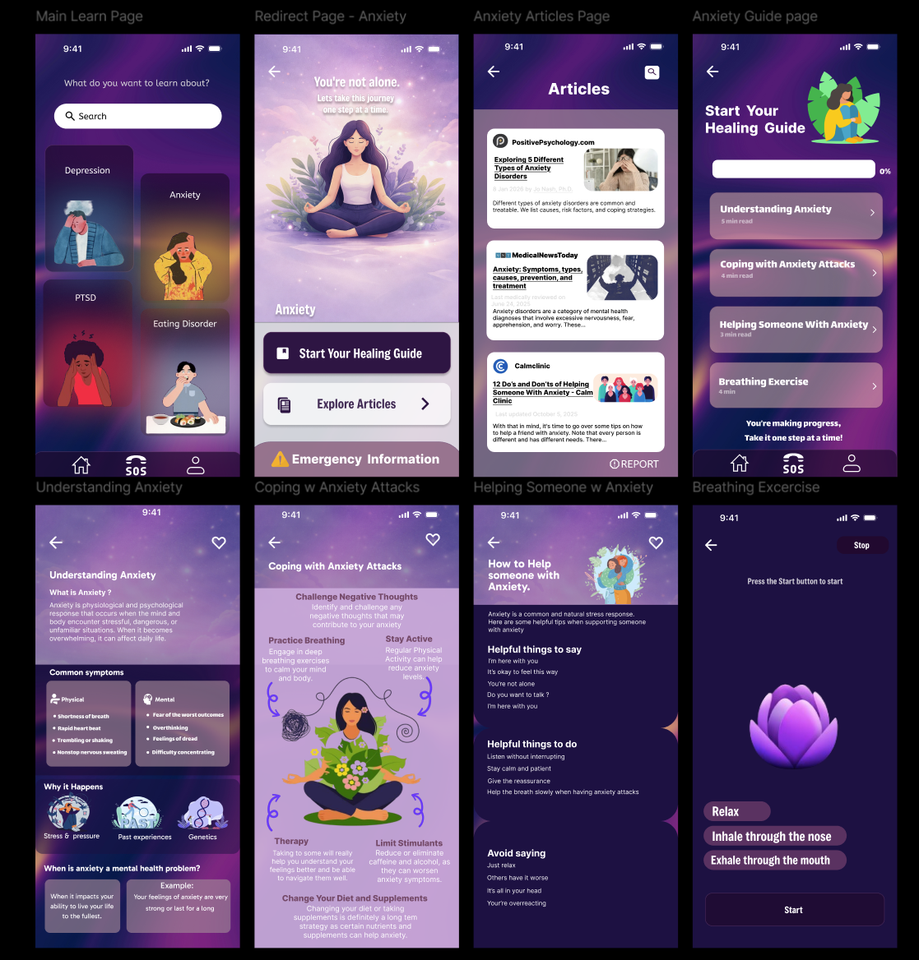
Human Computer Interface ICTE 3002
Low Fidelity → High Fidelity Evolution
Initial Layout
Basic layout and content structure
Refined Design
Enhanced with visuals, hierarchy, and UI elements
Improved readability and clarity through structured layout, visual hierarchy, and accessible design.
Natalee De Silva

Slide 26
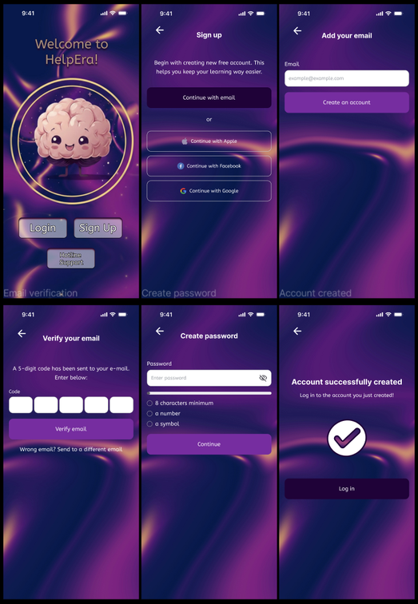
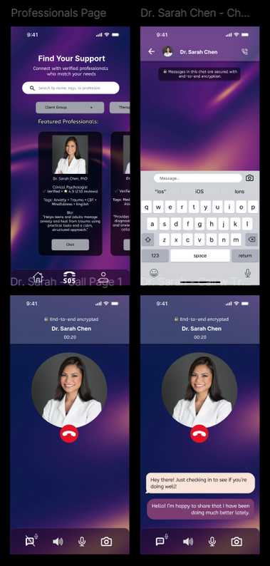
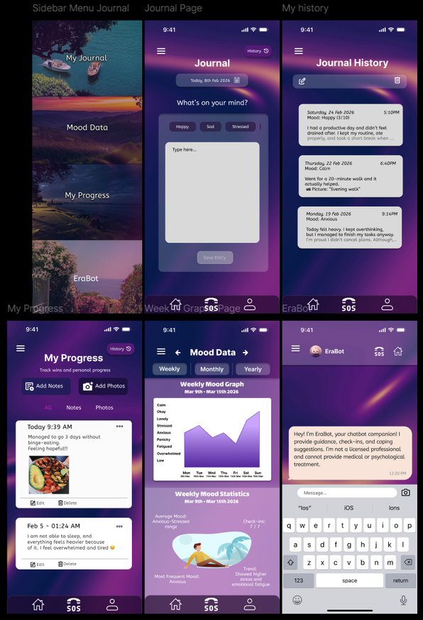
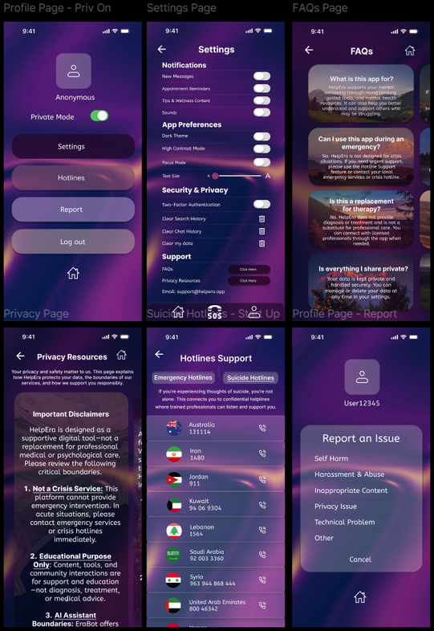
Human Computer Interface ICTE 3002
High Fidelity Prototype Screens
Startup Page &
Login/Signup
Professional Support
Journaling
Profile
Natalee De Silva

Slide 27
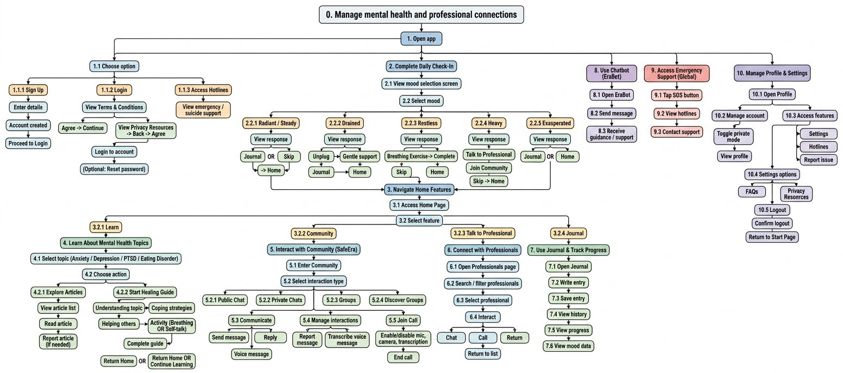
Human Computer Interface ICTE 3002
HTA of User Interactions
Natalee De Silva

Slide 28
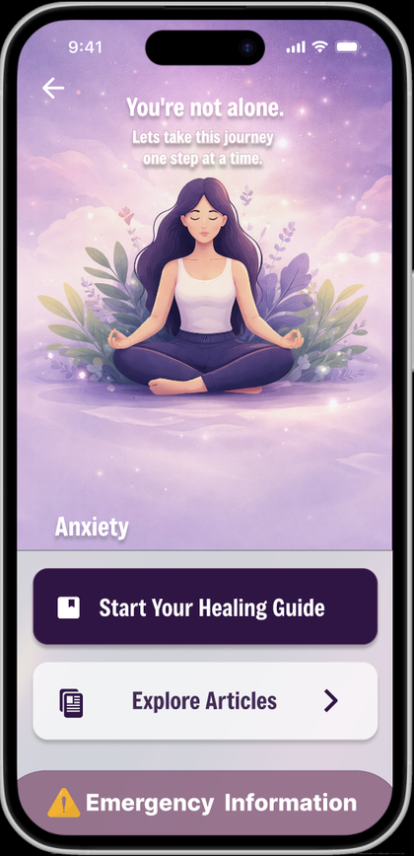
Human Computer Interface ICTE 3002
Usability Testing Summary
Positive Insights
  Limited safety features reduced user trust
  Emergency support lacked direct accessibility
  Repetitive check-ins lowered engagement
  Unclear AI boundaries caused confusion
Negative Insights
  Privacy features increased user confidence
  Wide emotion range supported self-expression
  Core concept was relevant and impactful
  Strong foundation of essential features
Natalee De Silva

Slide 29
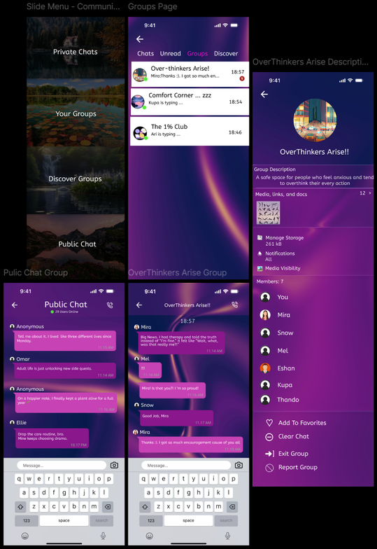
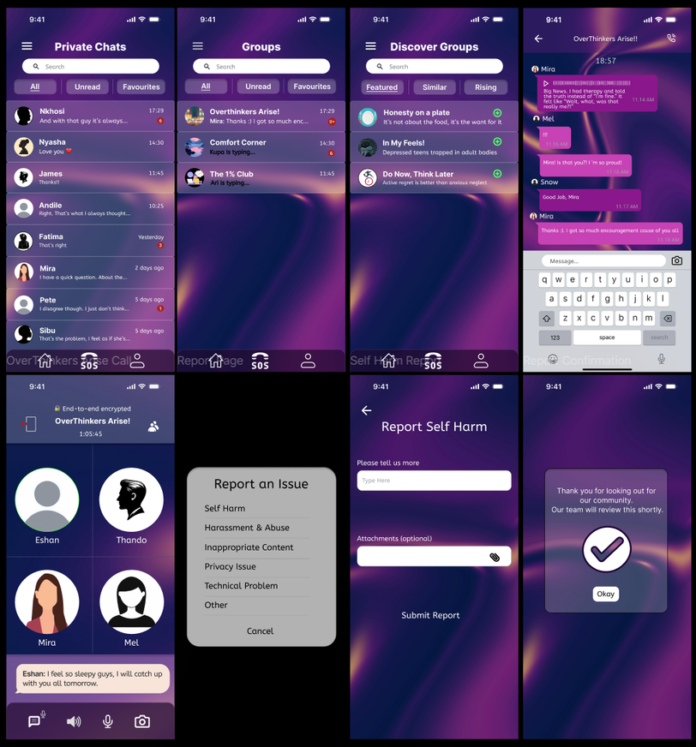
Human Computer Interface ICTE 3002
Final Improvements
Before → After
Improved usability and visuals by adding clear titles to navigated chats, transcription feature to audios in chats, and allowing users to report etc.
Natalee De Silva

Slide 30
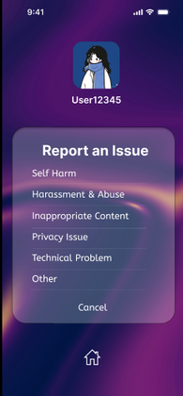
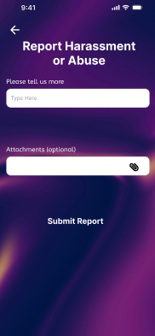
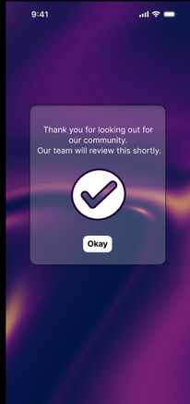
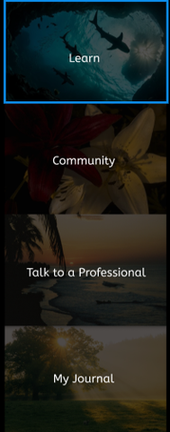

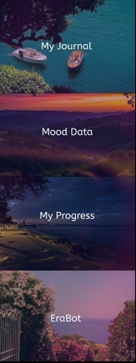
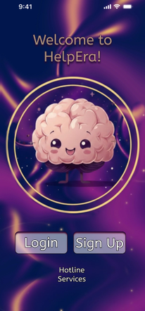
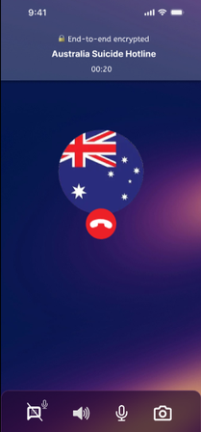
Human Computer Interface ICTE 3002
THE HELPERA EDGE
We optimized the user flow to ensure that even under high cognitive load (stress), the path to safety is subconscious and effortless.
HelpEra wasn't built for a "standard" user; it was built with accessibility at its core, ensuring those with low vision or motor impairments have equal access to protection.
The SOS buttons allows users to directly seek help in the case of an emergency in one tap, saving them the trouble of looking for them online.
Resham Furqan

Slide 31
Human Computer Interface ICTE 3002
FUTURE WORK
Backend & Infrastructure
AI & Advanced
Features
Scalability &
Platforms
Partnerships & Validation
  Transition from Figma to a live, functional backend.
  Secure user authentication and encrypted data storage.
  "Error Bot" integration for context-aware support.
  Sentiment detection for adaptive, mood-based check-ins.
  Cross-platform deployment (iOS, Android, and Web).
  Cloud-integrated architecture for global user growth.
  Clinical content validation by licensed professionals.
  Real-time integration with global emergency hotlines.
Resham Furqan

Slide 32



Human Computer Interface ICTE 3002
THANK YOU!
Presented by: UXplorers

